Slide 1
MARKETING ANALYTICS
SESSION 4:
ANALYZING CUSTOMER PREFERENCES
Professor Sonnier
Texas MSBA Program
Fall 2022

Slide 2
MEASURING CUSTOMER PREFERENCES
Value for Functional Attributes
Multi-Attribute Model for Marc’s Laptop Preferences
 | Importance of Attributes
 | 40% | 30% | 10% | 20%
 | Disk Space | RAM | Weight | Price | Preference
Lenovo | 10 | 10 | 4 | 6 | 8.6
Dell | 4 | 6 | 8 | 4 | 5.0
Sony | 4 | 6 | 10 | 5 | 5.4
How do we get the importance data?

Slide 3
MEASURING CUSTOMER PREFERENCES
Two Types of Preference Data
Revealed Preference Data
Data from the market
Consumers reveal their preferences through choices in the market
Stated Preference Data
Survey data
Respondents state their preferences or reveal them through experimental ratings, rankings, or choices

Slide 4

MEASURING CUSTOMER PREFERENCES
Stated Preferences, Directly Elicited from Consumers
If we want to know attribute importance could we just ask people directly?
How important are the following attributes?
brand
interest rate
annual fee
credit limit

Slide 5
MEASURING CUSTOMER PREFERENCES
Ask Direct Questions
How important are the following attributes
brand
interest rate
annual fee
credit limit
1
Not at All Important
10
Very Important

Slide 6
MEASURING CUSTOMER PREFERENCES
A Better Way: Ask the Question Indirectly
Please rate the likelihood of choosing each of the following
Visa
12% Interest
$20 Annual Fee
$1,000 Limit
Mastercard
10% Interest
$40 Annual Fee
$1,000 Limit
Do not ask directly about importance of interest rate or annual fee
Present realistic tradeoff scenarios and infer preferences from your ratings

Slide 7
MEASURING CUSTOMER PREFERENCES
Stated Preference Measurement
Direct
Directly elicit valuations from consumers
What is your value for farm raised salmon?
Indirect
Present product profiles
Salmon
Farm Raised
$12.99 per lb.
Elicit purchase response
How likely are you to purchase?
Use a model to infer valuations
Conjoint Analysis is method of indirect, stated preference measurement

Slide 8
CONJOINT IN PRACTICE
Preference as a Function of Price
Product A is the focal product
How does the share of respondents choosing A change as a function of the price of A?
How Does the Share of respondents choosing A change as a function of the price of B?

Slide 9
CONJOINT IN PRACTICE
Brand Valuation
Assume two products have the same physical characteristics but different brand names
What is the price difference that equalizes the shares of the two products?
Price
P’
Brand Value
P
D_{Prius}
D_{Civic Hybrid}
Q
Q’
Quantity

Slide 10
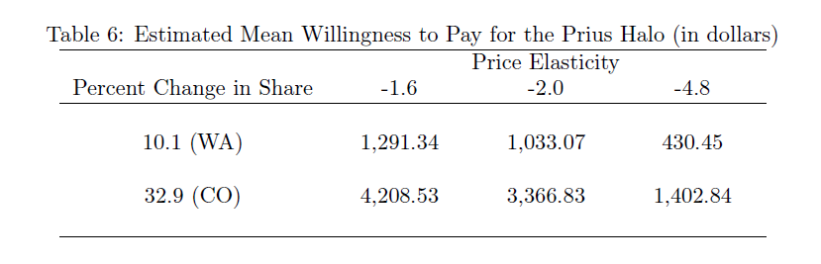
CONJOINT IN PRACTICE: EXAMPLE OUTPUT
Revealed vs. Stated Preferences
Median WTP: $1,100
Mean WTP: $4,760
Price Elasticity: -2.58

Slide 11
CONJOINT IN PRACTICE
Product Attribute Valuation
What is the value of a product attribute?
> Slide to unlock

Slide 12
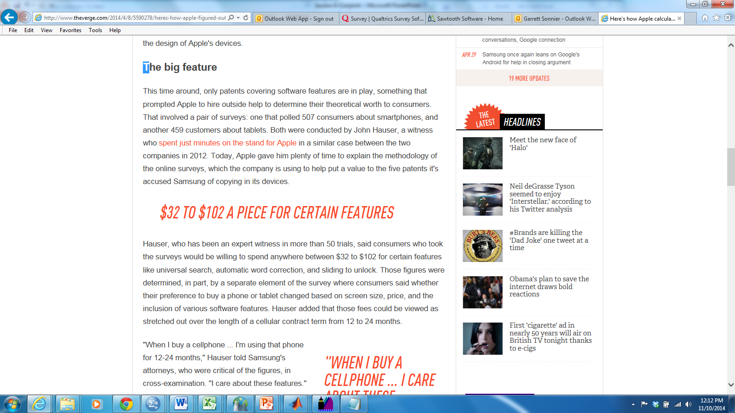
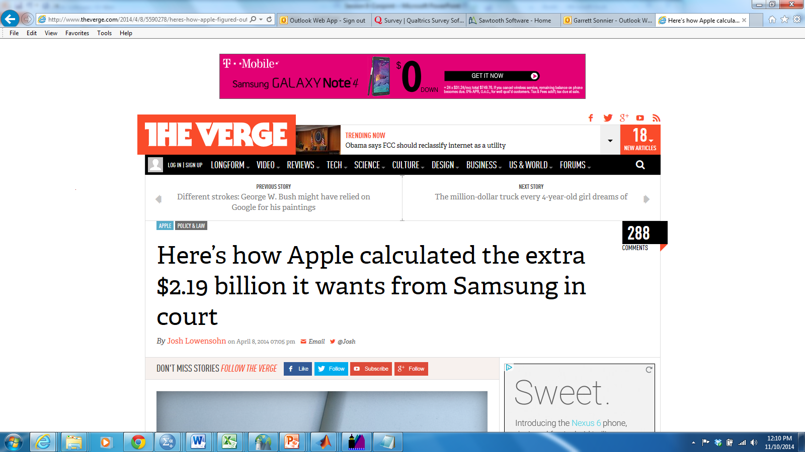
CONJOINT IN PRACTICE
Economic Damages in Lawsuits

Slide 13
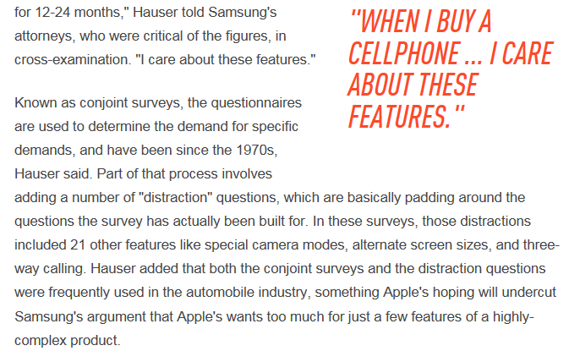
CONJOINT IN PRACTICE
Economic Damages in Lawsuits

Slide 14
CONJOINT ANALYSIS
Steps in the Process
Specify the attributes and levels in the study
Generate the design matrix of independent variables
Collect data
Estimate model
Analysis

Slide 15
CONJOINT ANALYSIS
Start with attributes and levels
Attributes
Levels
Brand | Engine | Price
Toyota | 200 HP V6 (22 MPG) | $29,000
Nissan | 170 HP V4 (28 MPG) | $27,000
Honda | 165 HP Hybrid (39 MPG) | $25,000
There are 3x3x3=27 possible configurations
Product space grows exponentially

Slide 16
CONJOINT ANALYSIS
Some Terminology
Design
The product combinations shown to consumers
Full Factorial Design
A design in which all possible product combinations are shown
For example, 3 attributes each with only 2 levels
Fractional Factorial Design
A fraction of the full factorial that permits efficient estimation of the parameters of interest. Usually seeks to impose orthogonality.
D-Optimal Design
Also a fractional design. Seeks to minimize covariance of parameter estimates for a given model. Allows some correlation and permits nonlinear and interaction terms.

Slide 17
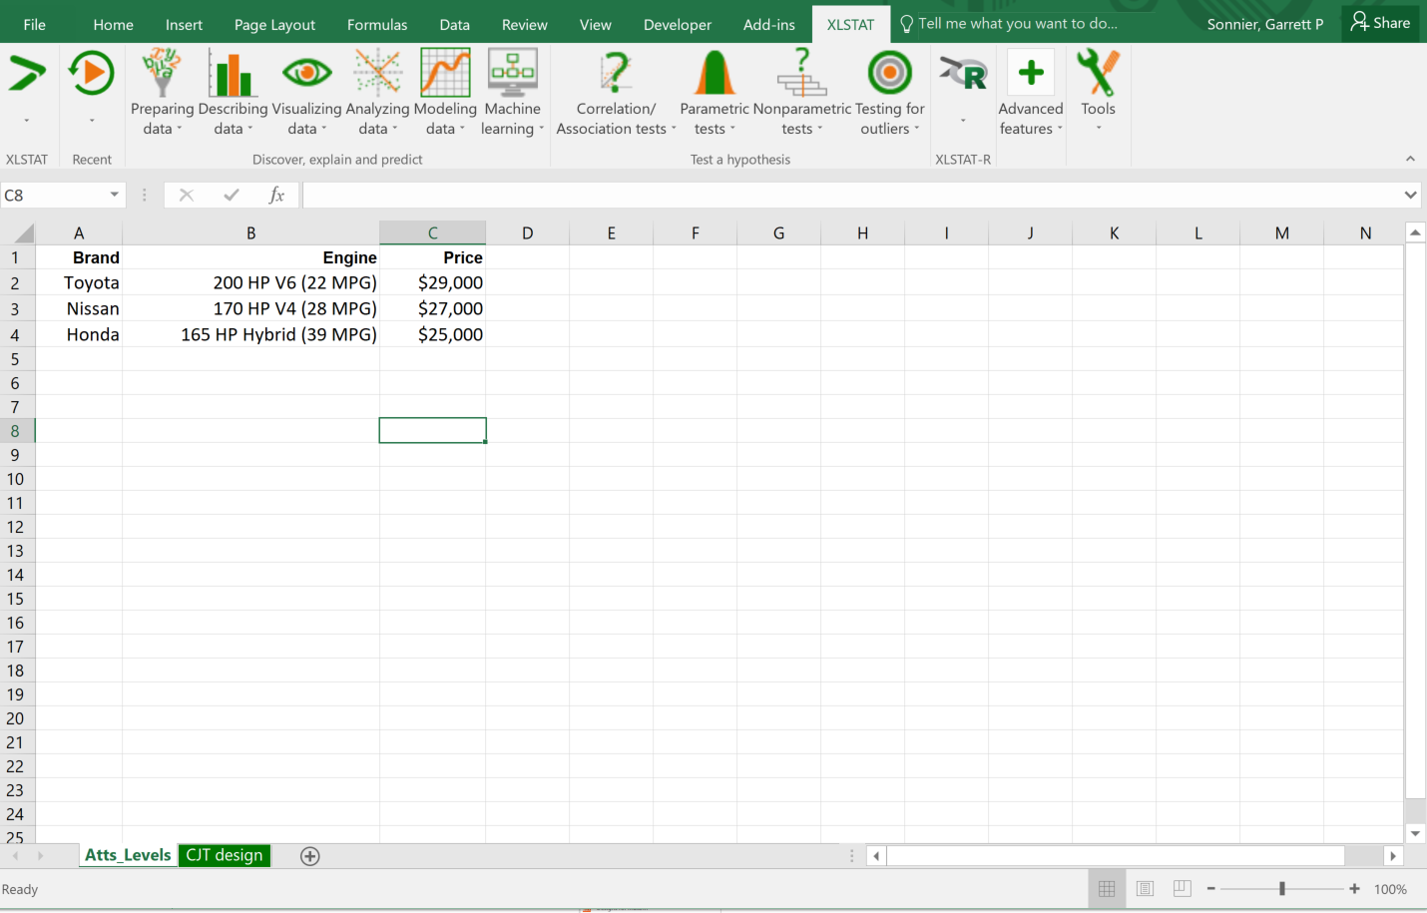
CONJOINT ANALYSIS
Generate Design

Slide 18
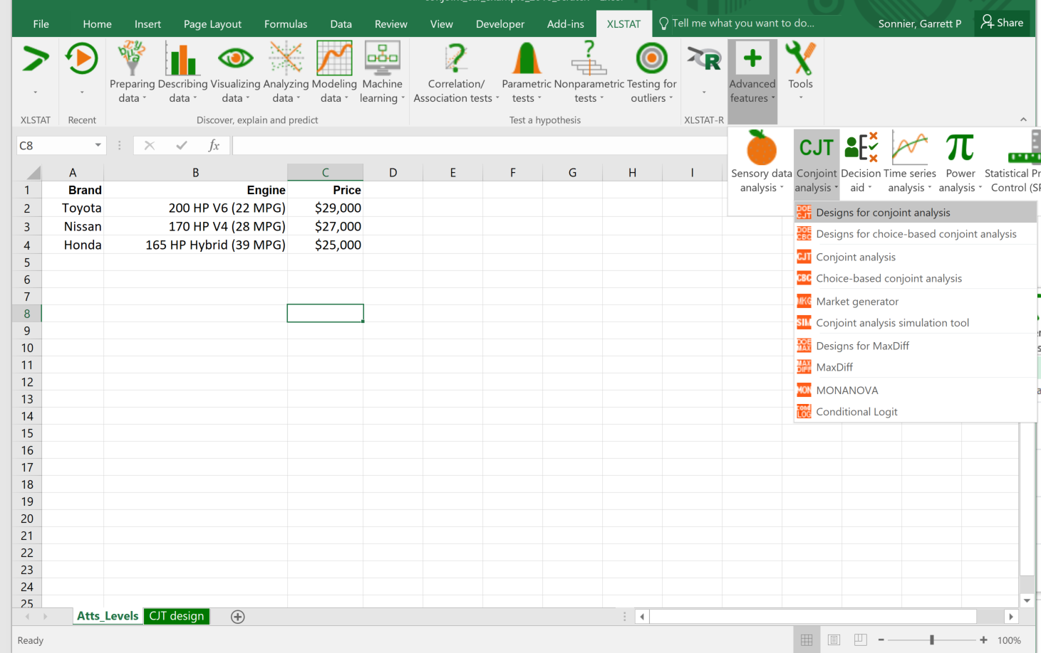
CONJOINT ANALYSIS
Generate Design

Slide 19
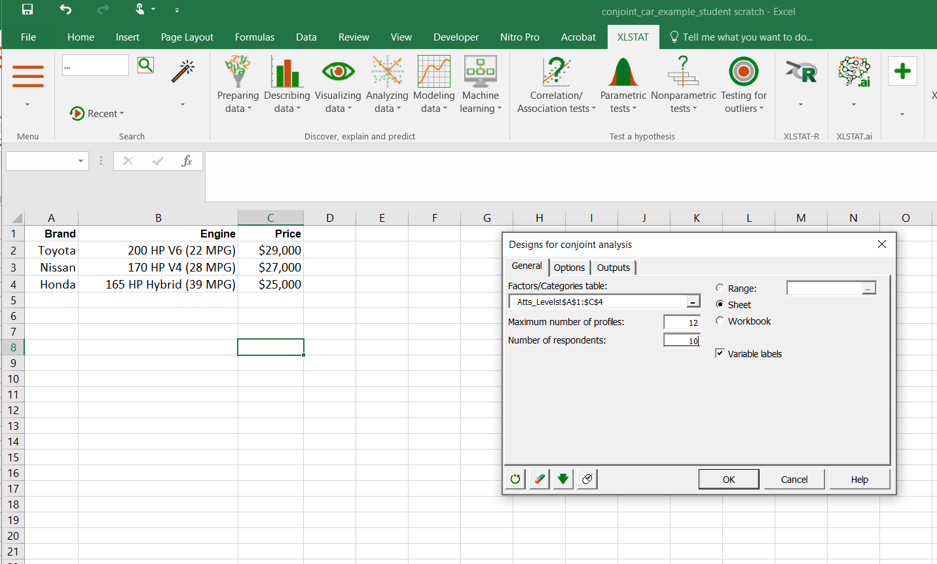
CONJOINT ANALYSIS IN XLSTAT
Generate Design

Slide 20
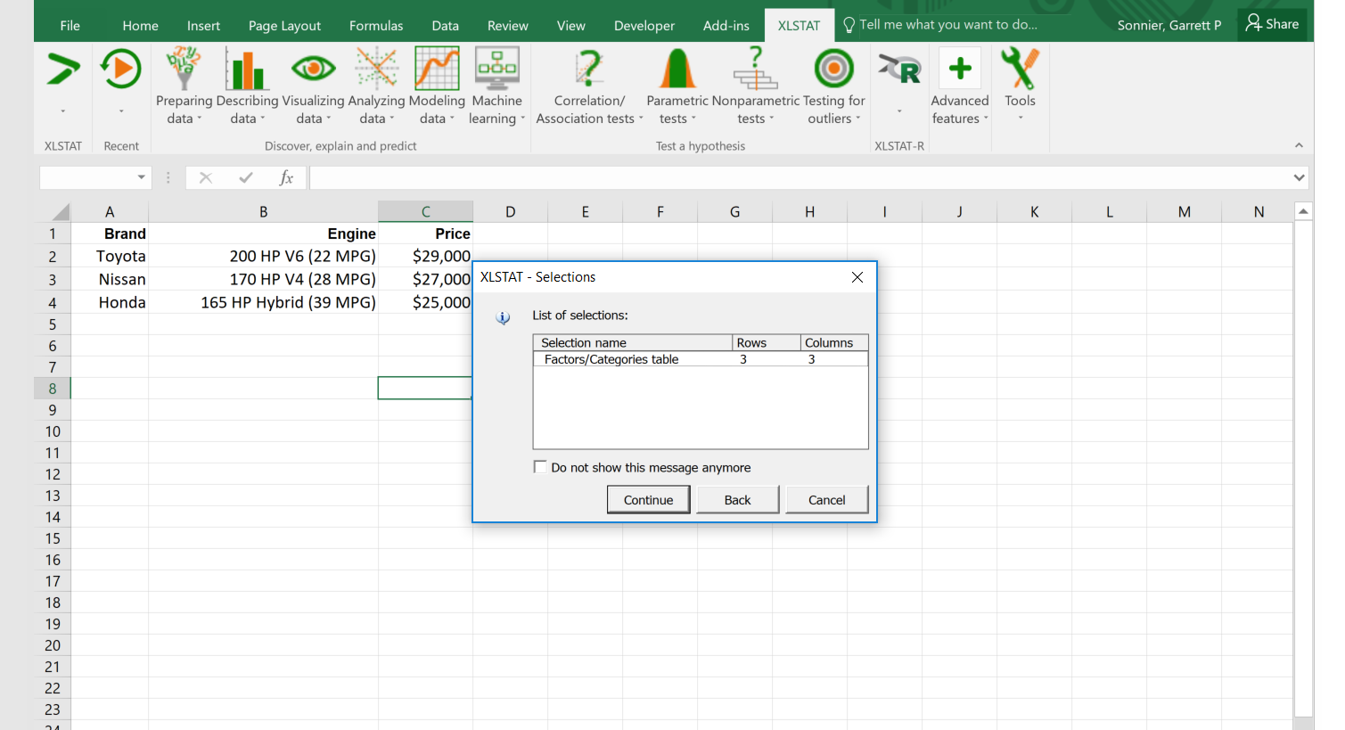
CONJOINT ANALYSIS IN XLSTAT
Generate Design

Slide 21
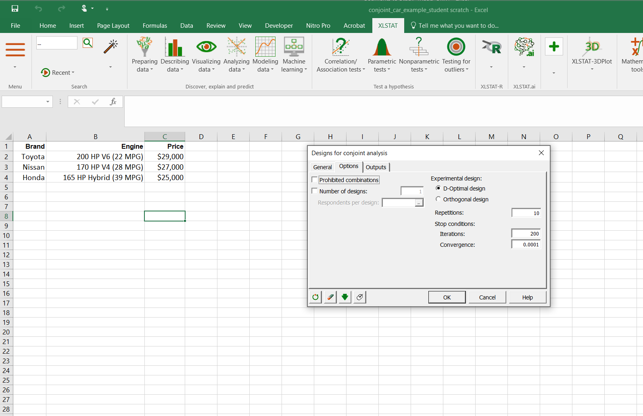
CONJOINT ANALYSIS IN XLSTAT
Generate Design

Slide 22
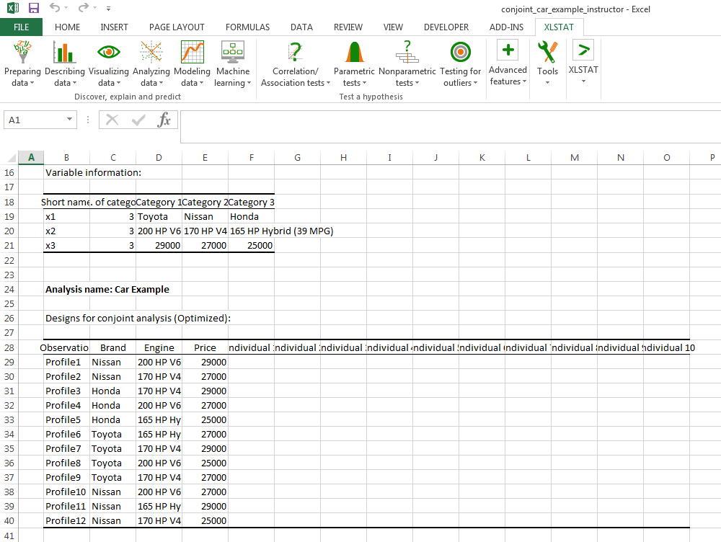
CONJOINT ANALYSIS IN XLSTAT
Generate Design

Slide 23
CONJOINT ANALYSIS DATA COLLECTION
Collect Data
Profile #1
Nissan
200 HP V6 (22 MPG)
$29,000
12 profiles to be rated
What does respondent do?
Rate each profile in terms of purchase likelihood (1 to 7)
Rank order the 12 profiles
For each profile, would you buy (yes/no)

Slide 24
CONJOINT ANALYSIS DATA AND MODELS
Collect Data and Estimate Model
First let’s think about the dependent variable (y)
What does respondent do?
Rate each profile in terms of purchase likelihood (1 to 10)
Rank order the profiles in terms of purchase likelihood
For each profile, would you buy (yes/no)
How to analyze the data?
Ratings Data---OLS Regression (or Ordered Choice Model)
Rankings Data---OLS Regression (or Ranking Choice Model)
Choice Data---Discrete Choice Model (not OLS Regression!)

Slide 25
CONJOINT ANALYSIS MODELS
Model Estimation
Now let’s think about independent variables (X)
How would we capture brand as an independent variable?

Slide 26
CONJOINT ANALYSIS MODELS
Model Estimation
Now let’s think about independent variables (X)
How would we capture brand as an independent variable?
Dummy coding
If you have J categories you need only J-1 dummy variables
Estimate J-1 regression coefficients
EXAMPLE

Slide 27
CONJOINT ANALYSIS MODELS
Model Estimation
Now let’s think about independent variables (X)
How would we capture price as an independent variable?

Slide 28
CONJOINT ANALYSIS MODELS
Model Estimation
Now let’s think about independent variables (X)
How would we capture price as an independent variable?
EXAMPLE

Slide 29
CONJOINT ANALYSIS MODELS
Model Estimation
We could code price as a linear attribute
Only requires one regression coefficient
Price Increase from $25K to $26K
(26-25) x (-0.75) = -0.75
Price Increase from $26K to $27K
(27-26) x (-0.75) = -0.75
Price Increase from $25K to $29K
(29-25) x (-0.75) = -3
Price Weight from Regression: -0.75

Slide 30
CONJOINT ANALYSIS MODELS
Data for Model Estimation: Example for Single Respondent
We can use OLS regression analysis to estimate the beta coefficients

Slide 31
CONJOINT ANALYSIS MODELS
Model Coefficients
Model for One Individual
EXAMPLE

Slide 32
CONJOINT ANALYSIS REVIEW
Analysis: Attribute Importance
Between brand and price which is the more important attribute and why

Slide 33
CONJOINT ANALYSIS OUTPUT
Preference Analysis and Brand Value
Concept 1
Brand | Engine | Price
Toyota | 165 HP Hybrid | $27,000
Concept 2
Brand | Engine | Price
Honda | 200 HP V6 | $25,000
Concept 1
Concept 2
Respondent 4
4.22
4.22
+
2.92
+
0
+
0
+
-1.28
+
-0.36
+
0
6.79
2.94

Slide 34
CONJOINT ANALYSIS REVIEW
Brand Value
Concept 1
Brand | Engine | Price
Toyota | 165 HP Hybrid | $25,000
Concept 2
Brand | Engine | Price
Honda | 165 HP Hybrid | $25,000
Concept 1
Concept 2
Respondent 4
2.92 point difference
4.22
4.22
Toyota can be $29,000 and still be preferred
+
2.92
+
0
+
0
+
0
+
0
+
0
7.14
4.22

Slide 35
CONJOINT ANALYSIS OUTPUT
Brand Value
Concept 1
Brand | Engine | Price
Toyota | 165 HP Hybrid | $25,000
Concept 2
Brand | Engine | Price
Honda | 165 HP Hybrid | $25,000
Concept 1
Concept 2
0.89 point difference
Respondent 1
5.59
5.59
Toyota can be $27,000 and still be slightly preferred
+
0.89
+
0
+
0
+
0
+
0
+
0
6.49
5.59

Slide 36
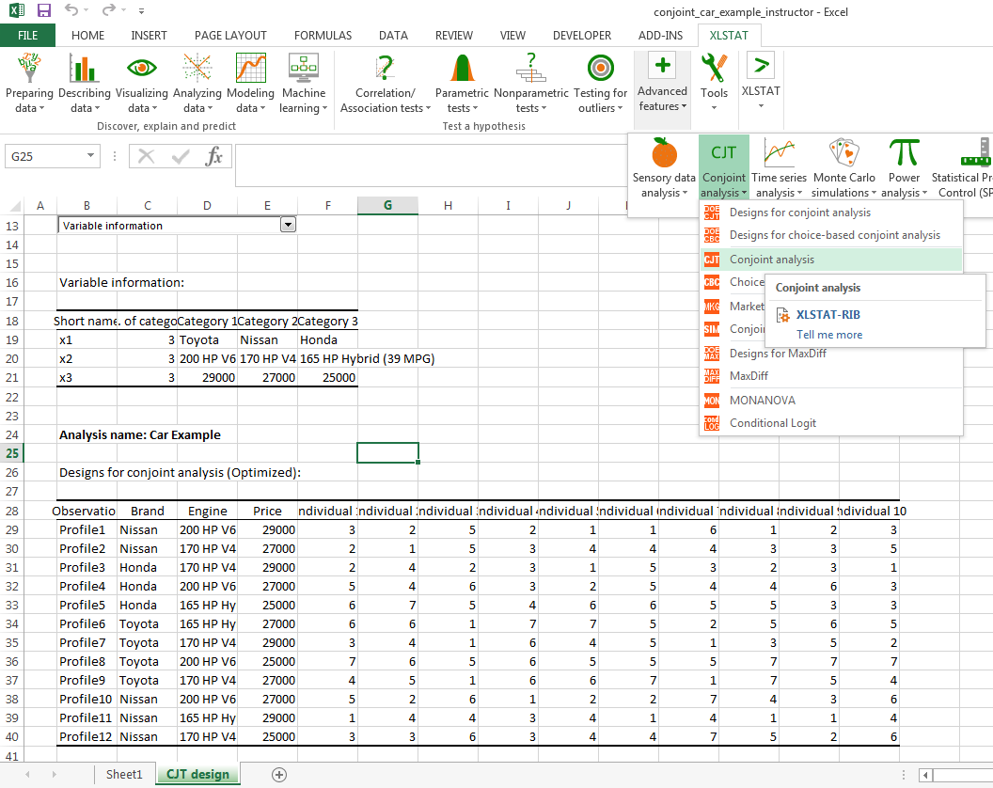
CONJOINT ANALYSIS IN XLSTAT
Click on Conjoint Analysis Ribbon

Slide 37
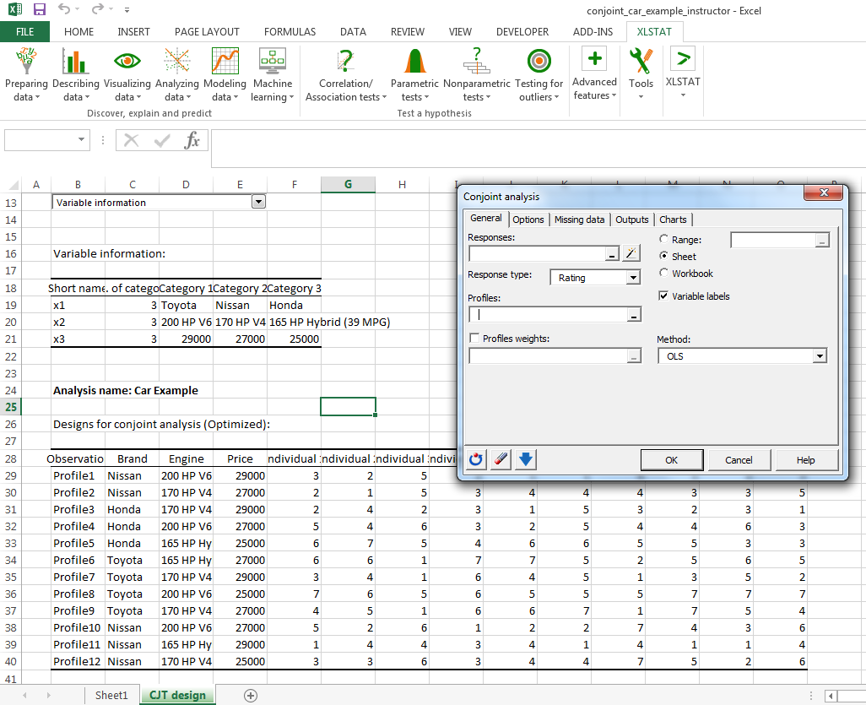
CONJOINT ANALYSIS IN XLSTAT
Load Responses and Profiles

Slide 38
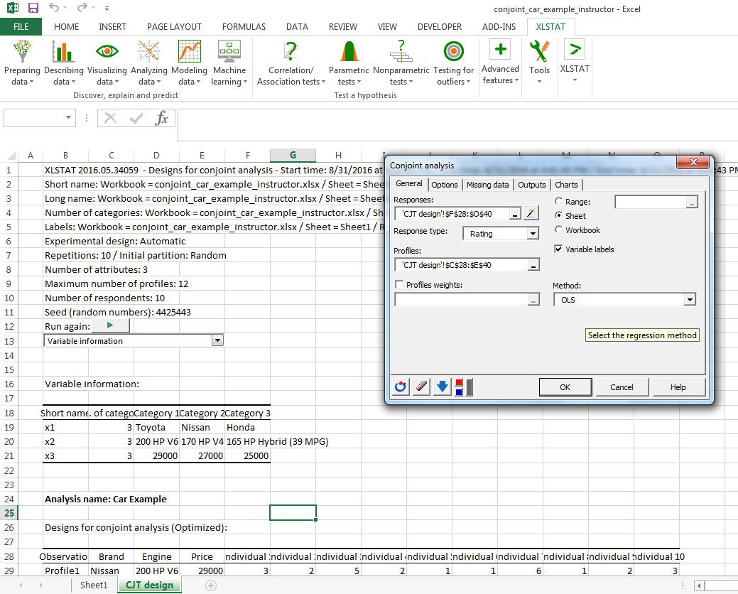
CONJOINT ANALYSIS IN XLSTAT
Select Response Type (Rating) and Method (OLS)

Slide 39

CONJOINT ANALYSIS IN XLSTAT
Select Constraint (a1=0)

Slide 40
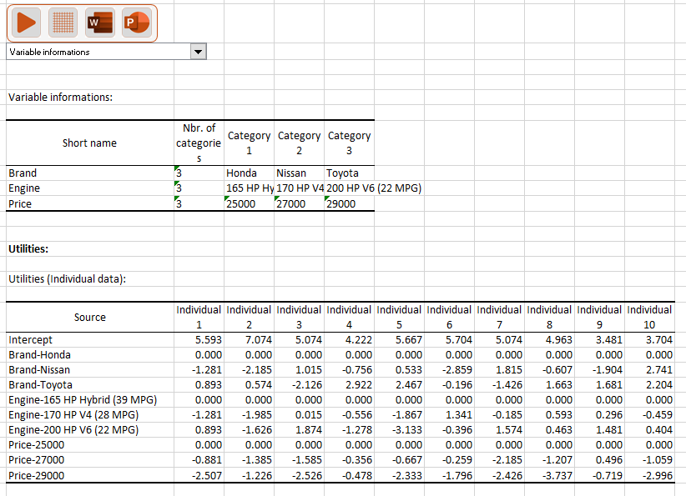
CONJOINT ANALYSIS IN XLSTAT
Behold! Results!

Slide 41
CONJOINT ANALYSIS IN XLSTAT
Utilities
How to interpret the Intercept?
What about the other coefficients?

Slide 42
CONJOINT ANALYSIS IN XLSTAT
Utilities: Descriptive Stats

Slide 43
CONJOINT ANALYSIS REVIEW
Analysis: Attribute Importance
Between brand and price which is the more important attribute and why

Slide 44
CONJOINT ANALYSIS IN XLSTAT
Attribute Importance

Slide 45
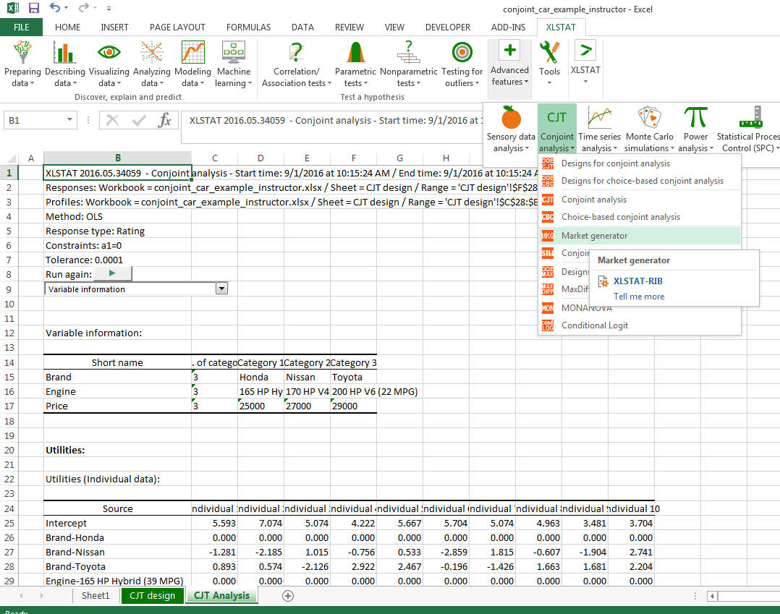
MARKET SIMULATIONS IN XLSTAT
Click on Market Generator

Slide 46
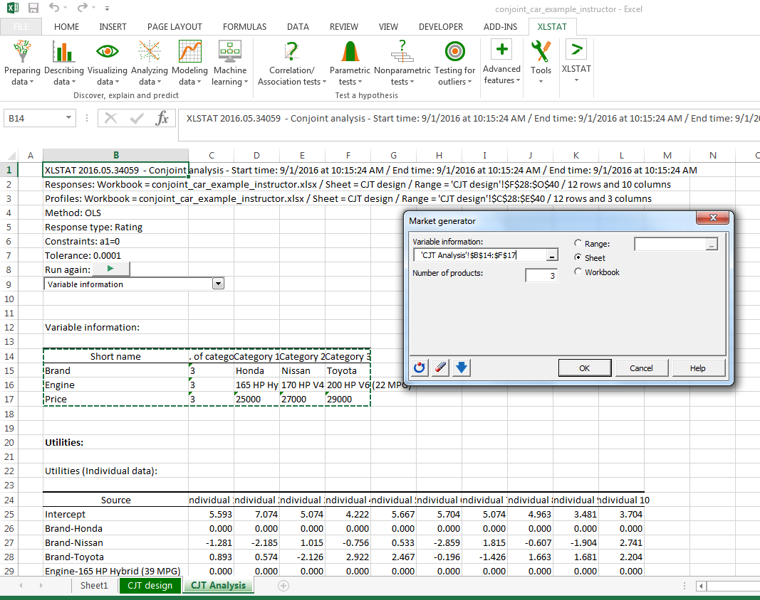
MARKET SIMULATIONS IN XLSTAT
Select Variable Information and Number of Products

Slide 47
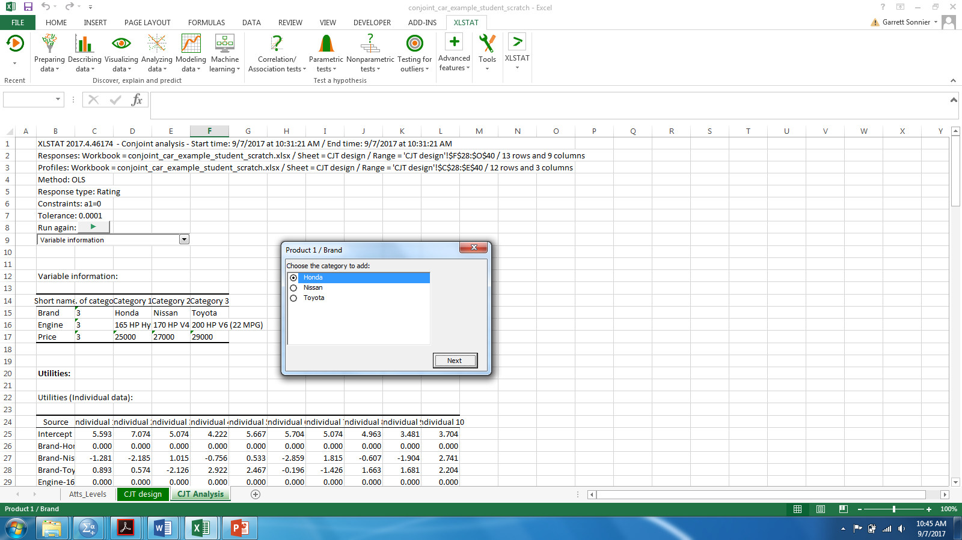
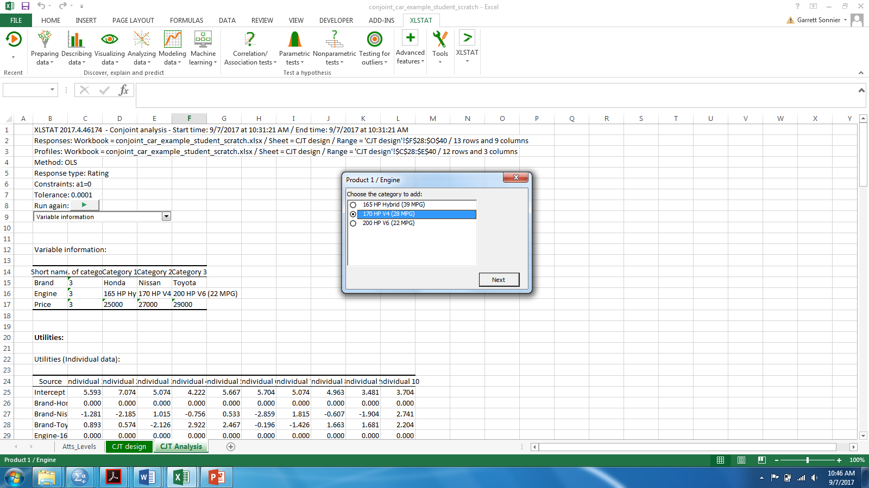
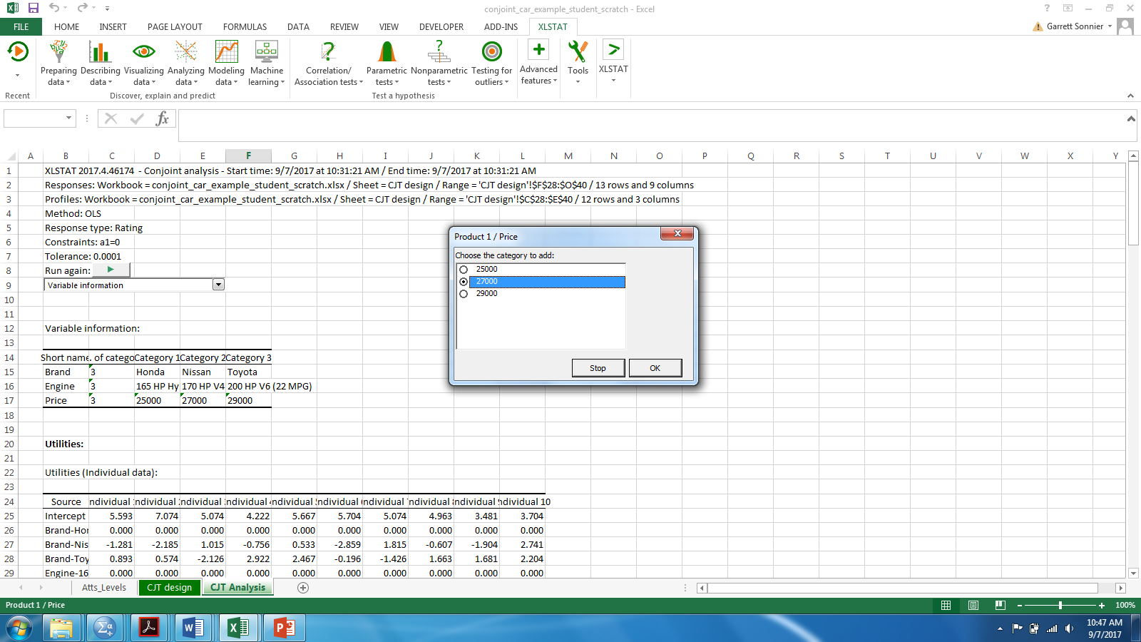
MARKET SIMULATIONS IN XLSTAT
Build the Products by Choosing a Brand, Engine and Price

Slide 48
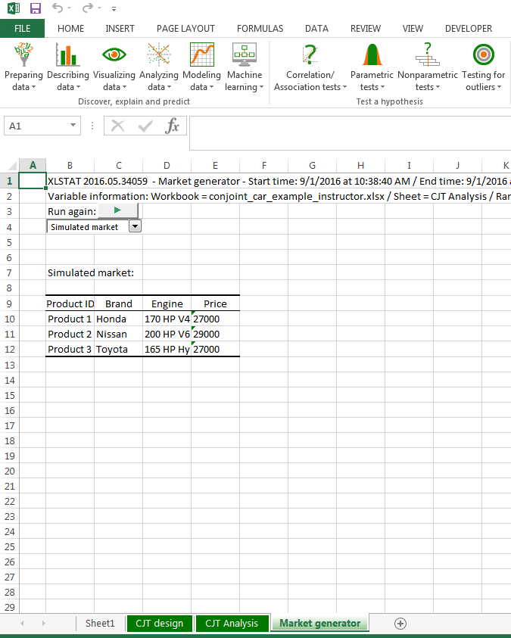
MARKET SIMULATIONS IN XLSTAT
Three Product Market Generated

Slide 49
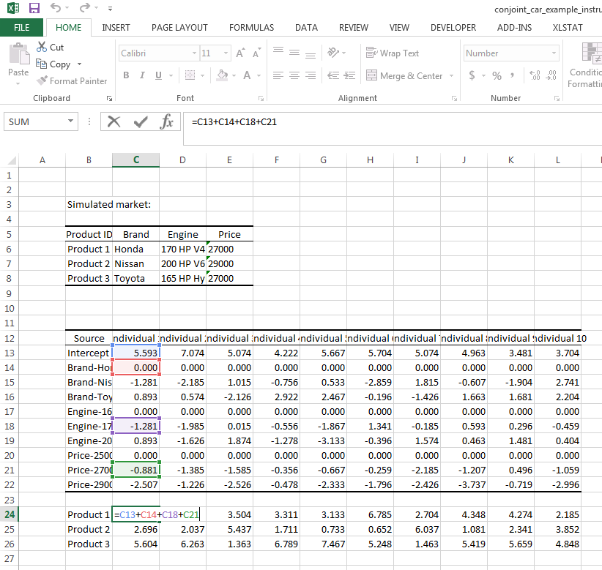
MARKET SIMULATIONS: WHAT IS XLSTAT DOING?
Three Product Market: Compute Total Utility

Slide 50
MARKET SIMULATIONS: WHAT IS XLSTAT DOING???
First Choice Rule
Product With Highest Utility is Chosen with Certainty

Slide 51
MARKET SIMULATIONS: WHAT IS XLSTAT DOING???
Logit Rule
Computes the probability of choice as a function of utility

Slide 52
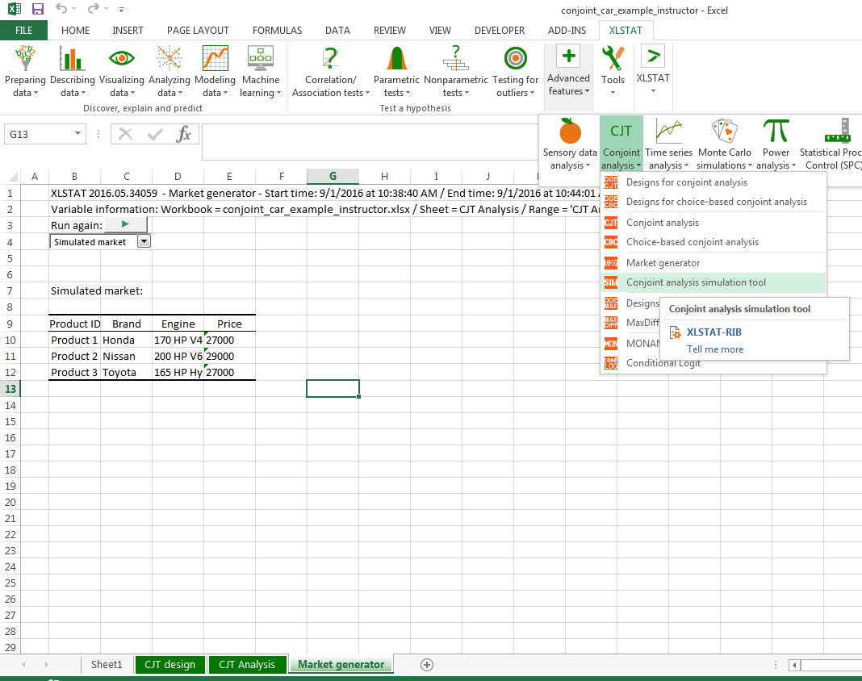
MARKET SIMULATIONS: WHAT IS XLSTAT DOING???
Click on Conjoint analysis simulation tool

Slide 53
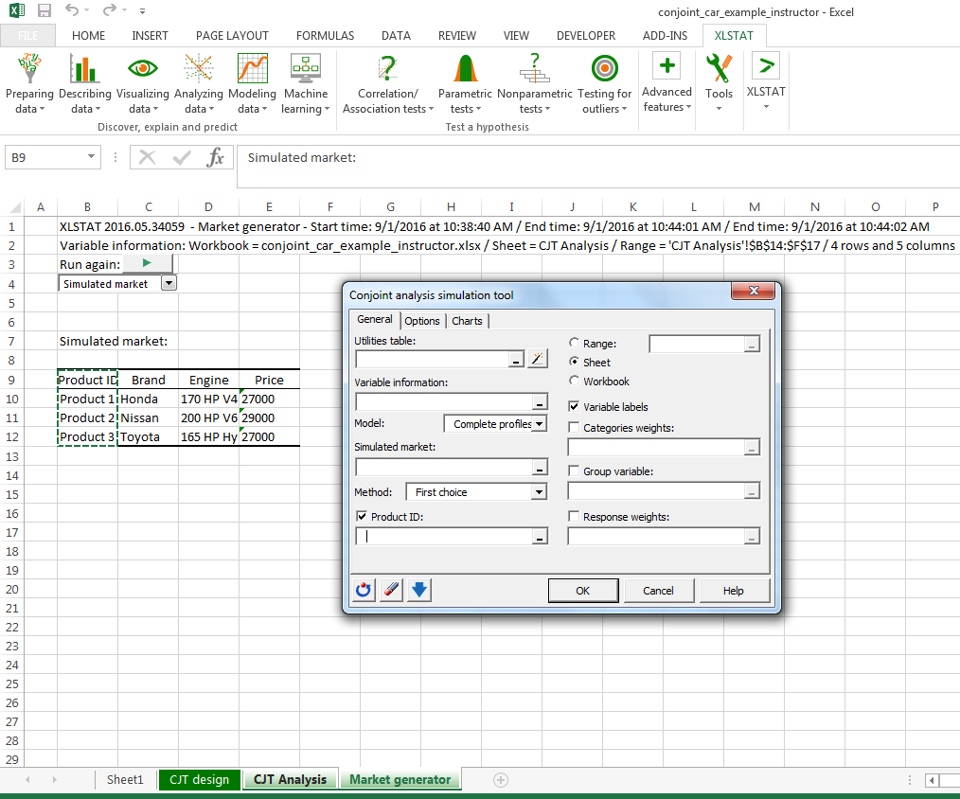
MARKET SIMULATIONS IN XLSTAT
Load Analysis and Market Report Data

Slide 54
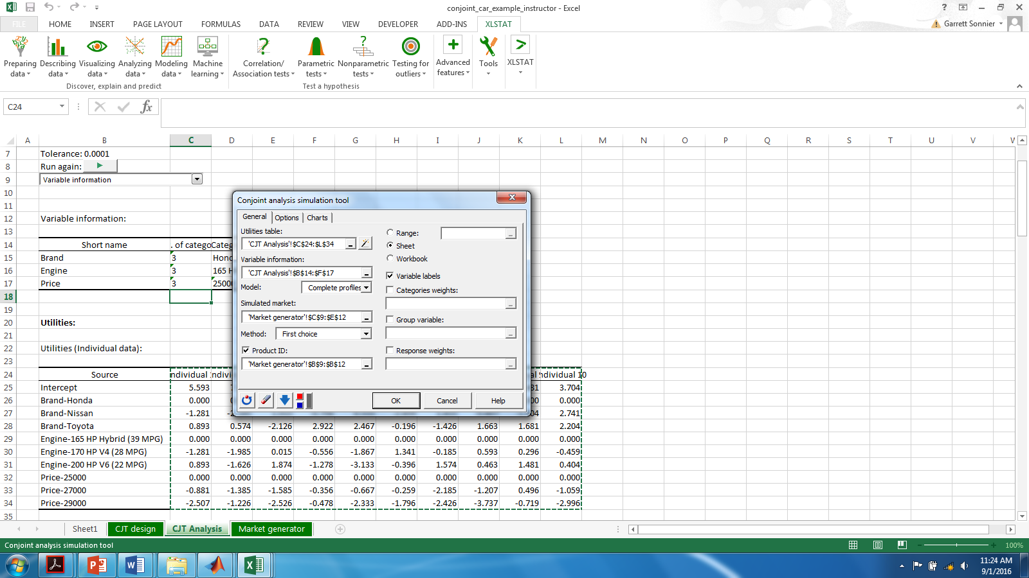
MARKET SIMULATIONS IN XLSTAT
Select Model (Complete Profile) and Method (First Choice)

Slide 55
MARKET SIMULATIONS IN XLSTAT
Simulation Output

Slide 56
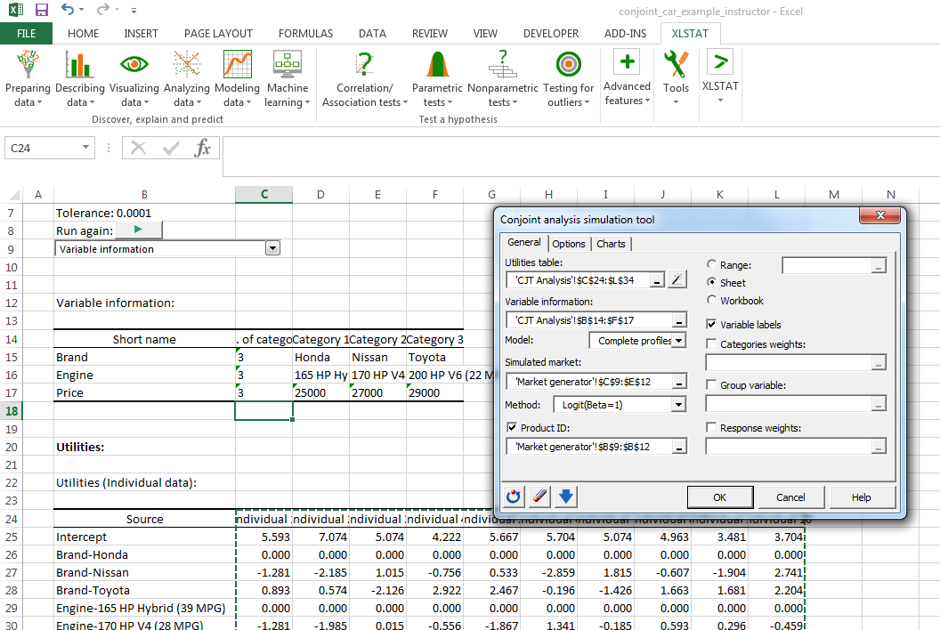
MARKET SIMULATIONS IN XLSTAT
Using the Logit Rule

Slide 57
MARKET SIMULATIONS IN XLSTAT
Simulation Output

Slide 58
CONJOINT ANALYSIS REVIEW
Elasticities
Honda
Nissan
Toyota

Slide 59
MARKETING ANALYTICS
Key Concepts from Today
Revealed vs. Stated Preferences
Conjoint is a method to measure stated preferences via indirect elicitation
Regression analysis of product ratings as a function of product characteristics
Attribute importance
Dollar-metric valuation
Market share analysis

